Slide 1
Apache Hadoop - YARN
The Evolution of Hadoop

Slide 2
Objectives
The big data problem.
The Hadoop Ecosystem comes to rescue!
Hadoop 1.0 Architecture and limitations.
How Hadoop 2.0 overcomes the challenges.

Slide 3



Big Data Use Case
Notes:
Facebook generates 500TB data everyday. This includes 2.5 Billion content items, 2.7 Billion ‘likes’, 300 Million Photos uploaded, etc. Walmart is an online shopping store, which generates upto 5PB data everyday. Tipp24 is a gaming site which generates 2PB data everyday. The use cases go along…

Slide 4

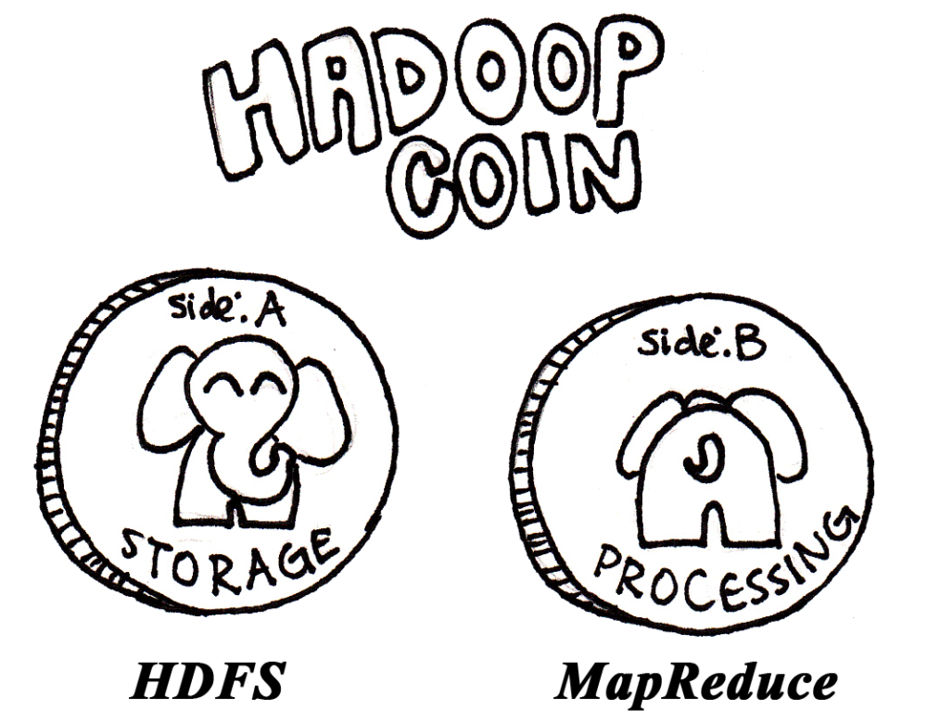
Hadoop 1.0 – In Summary
Notes:
Hadoop is a platform of two extremes. One for storing huge amounts of data which uses a distributed file system (Hadoop Distributed File System – HDFS) where files are distributed across commodity hardware. The other for computational processing on this data (MapReduce)

Slide 5

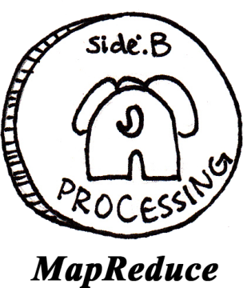




NS
…
…
…
…

Slide 6
Limitations of Hadoop 1.0
Issue of Scalability.
Doesn’t support NameNode high availability.
The JobTracker is overburdened.
Running Non-MapReduce Big Data Applications is not possible.
Multi-tenancy issue.

Slide 7


Challenges with Horizontal Scaling
Challenges:
Meta data is stored in NameNode Memory
Bottleneck after ~4000 nodes
Results in cascading failures.
NS
…

Slide 8


NameNode – Single Point of Failure
Metadata
Secondary NameNode:
“Not a Hot Standby” for the NameNode.
Connects to NameNode regularly.
Housekeeping , backup of NameNode metadata.
Saved metadata can build a failed NameNode.
What if I go down?
You give me Metadata every hour, I will make it secure

Slide 9

Job Tracker - Overburdened
CPU
“I have to schedule and monitor the jobs, and also do the resource managing. So heavy am I!!!”
Spends a very significant portion of time and effort managing the life cycle of applications.
Network
Single Listener Thread to communicate with thousands of Map and Reduce Jobs.
…
Task Trackers

Slide 10
Limitation in Running Non-MapReduce Applications
“I only obey MapReduce Programming Framework”
Problem in performing real-time analysis.
Problem in running message-passing approach.
Problem in running ad-hoc query.

Slide 11

Mein hoon YARN!

Slide 12
Hadoop 2.0
The following are the four main improvements in Hadoop 2.0 over Hadoop 1.x:
HDFS Federation: Horizontal Scalability of NameNode.
NameNode High Availability: NameNode is no more a Single Point of Failure.
YARN: Ability to process Terabytes and Petabytes of data available in HDFS using non-MapReduce applications like MPI, GIRAPH, etc.
Resource Manager: Splits up the two major functionalities of the overburdened JobTracker (Resource Management and Job Scheduling/Monitoring) into two separate daemons: A global ResourceManager (RM) and per-application ApplicationMaster (AM).

Slide 13
Hadoop 1.0 Vs Hadoop 2.0
Hadoop 1.0
MapReduce
(Cluster Resource Management & Data Processing)
HDFS
(File Storage)
Hadoop 2.0
MapReduce
(Data Processing)
Others
(Data Processing)
YARN
(Cluster Resource Management & Data Processing)
HDFS
(File Storage)

Slide 14

YARN
Yet Another Resource Negotiator
Batch
(MapReduce)
Interactive
(Text)
Online
(HBase)
Streaming
(Strom, S4,…)
Graph
(Giraph)
Other
(Search, Weave)
YARN (Cluster Resource Management)
HDFS (Redundant, reliable storage)

Slide 15
YARN - Ecosystem
Pig
Script
Hive
Query
Other YARN Frameworks
Hcatalog
Metadata Services
HBase
Non-relational Database
Other Projects
Ambari, Avro, Cassandra, Oozie, Zookeeper, Etc.
MapReduce
Distributed Processing
YARN
Resource Scheduling & Negotiation
HDFS
Distributed Storage

Slide 16
YARN - Components
ResourceManager
Master of the Cluster
NodeManager
Slave to take care of one Node
ApplicationMaster
Master of an application
Container
Resource Abstraction, process to complete a task.

Slide 17


YARN – Resource Manager
YARN: MapReduce, you only do Data Processing, because you’re best at it. Let me do Cluster Resource Management
Data Processing
Resource Manager

Slide 18
YARN – Resource Manager
Client
Resource Manager
Scheduler
Applications Manager
Masters
Node Manager
Node Manager
Container
App Master
App Master
Container
Slaves
Data Node
Data Node

Slide 19
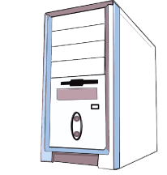
Resource Manager
Resource
Manager
Resource Manager
Resource Scheduler
AM Liveliness Monitor
NM Liveliness Monitor
Several Event Handlers
Scheduler
Responsible for allocating resources to the various running applications subject to familiar constraints of capacities, queues, etc.
ApplicationsManager
Responsible for accepting job submissions, negotiating the first container for executing the container for ApplicationMaster.

Slide 20
Node Manager
Node Manager
Node
Manager
Container #1
Container #2
Container #3
NodeStatusUpdater
Registers with RM and sends information about the resources available on the nodes.
ContainerManager
Core of NM, which contains RPC Server, ContainerLauncher, ContainerMonitor, LogHandler, etc.
ContainerExecuter
Interacts with underlying operating system to securely place files and directories needed by containers and subsequently launch and cleanup processes corresponding to containers.

Slide 21
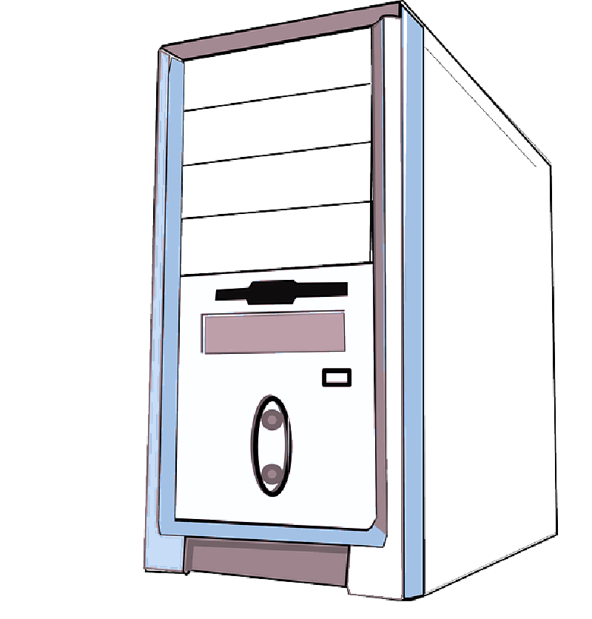
ApplicationMaster
NodeManager
Container
AppMaster
Heartbeat
Resource
Manager

Slide 22
Containers
NodeManager
Container
Container
AppMaster
AppMaster
Represents a resource (memory) on a single node at a given cluster.
It is supervised by the NodeManager.
Created on request by the ResourceManager.
Applications run in one or more containers.

Slide 23
Containers
Variable | Default Value | Description
yarn.scheduler.minimum-allocation-mb | 1024 | Minimum memory (in MB) allocation for every container request at RM.
yarn.scheduler.maximum-allocation-mb | 8192 | Maximum memory (in MB) allocation for every container request at RM.
yarn.scheduler.minimum-allocation-vcores | 1 | Minimum number of virtual cores for every container request at RM.
yarn.scheduler.maximum-allocation-vcores | 32 | Maximum number of virtual cores for every container request at RM.
yarn.nodemanager.resource.memory-mb | 8192 | Amount of Physical Memory that can be allocated for containers.
yarn.nodemanager.resource.cpu-vcores | 8 | Number of vcores that can be allocated for containers.

Slide 24
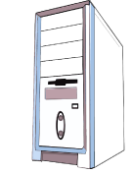
Resource Request
Represents the request made by an application to the RM to obtain various container allocations.
It Includes:
Priority of the request.
Name of machine or rack (* signifies that any host/rack is acceptable).
Resource required for each request.
Number of containers required by the application.
NodeManager
Resource
Manager
ApplicationMaster

Slide 25

Shuffle Services
Required for parallel MapReduce job operation.
Reducers fetch the output from all of the Maps by “Shuffling” Map output data from the corresponding nodes where the map tasks have run.
It is implemented as a helping service in Node Manager.
Hadoop 2.0 provides for Encrypted Shuffle where HTTPS optional client authentication is provided.

Slide 26
YARN - Cluster
Resource
Manager
Node
Manager
Node
Manager
Node
Manager

Slide 27

YARN Cluster – Running a MapReduce Application
NodeManager
Job
Job
NodeManager
MRAppMaster
Resource
Manager
NodeManager
Job
Launch AM
Resource Request
Container IDs
NodeManager
Launch Job in Containers

Slide 28
The Players
Resource
Manager
Client
Node
Manager
Node
Manager
Node
Manager
Container
MRAppMaster

Slide 29



The Players
The Client, which submits the MapReduce Job.
The YARN resource manager, which coordinates allocation of compute resources on the cluster.
Resource
Manager
The YARN node manager, which launch and monitor the compute containers on the machines in the cluster.
Node
Manager
The YARN MapReduce Application Master, which coordinates the tasks running the MapReduce Job.
MRAppMaster
The Distributed File System, which is used for sharing job files between the other entities.

Slide 30
MRAppMaster
Applications Manager (AsM)
1
NodeManager
Container
Container
MRAppMaster
MRAppMaster
1. Choose a NodeManager to launch the MapReduce application master class (MRAppMaster).

Slide 31
Job Submission
Client Node
Client JVM
2
MapReduce Program
1
Resource
Manager
Job
4
3
Run Job.
Get new Application ID.
Copy Job resources.
Submit Application.

Slide 32
Job Initialization
NodeManager
5a
Resource
Manager
5b
MRAppMaster
6
7
5a. Start Container.
5b. Launch AM.
6. Initialize Job.
7. Retrieve Input Splits.

Slide 33
Task Assignment
NodeManager
Resource
Manager
8
MRAppMaster
8. Request Resources
Request includes:
Information about each map task’s data locality.
Memory requirements of the task.

Slide 34
Task Execution
NodeManager
NodeManager
9a
9b
MRAppMaster
Task JVM
YARN Child
10
11
Map Task or Reduce Task
9a. Start Container.
9b. Launch main in YarnChild.
10. Retrieve Job resources.
11. Run Map/Reduce tasks.

Slide 35
Progress and Status Updates
Client Node
Resource
Manager
Client JVM
MapReduce Program
NodeManager
Job
Task JVM
NodeManager
YARN Child
MRAppMaster
Map Task or Reduce Task

Slide 36



YARN MapReduce Compatibility
Data Locality
Application Priorities
Node Failure

Slide 37


Elephants Can Remember
Look at key metrics for a MapReduce Job.
Understand the performance of each job.
Optimize future job runs.
Resource
Manager Web UI
Job History Server

Slide 38
